Slide 1


Terraform
B
Y
K
U
M
A
R
B
Y
K
U
M
A
R

Slide 2
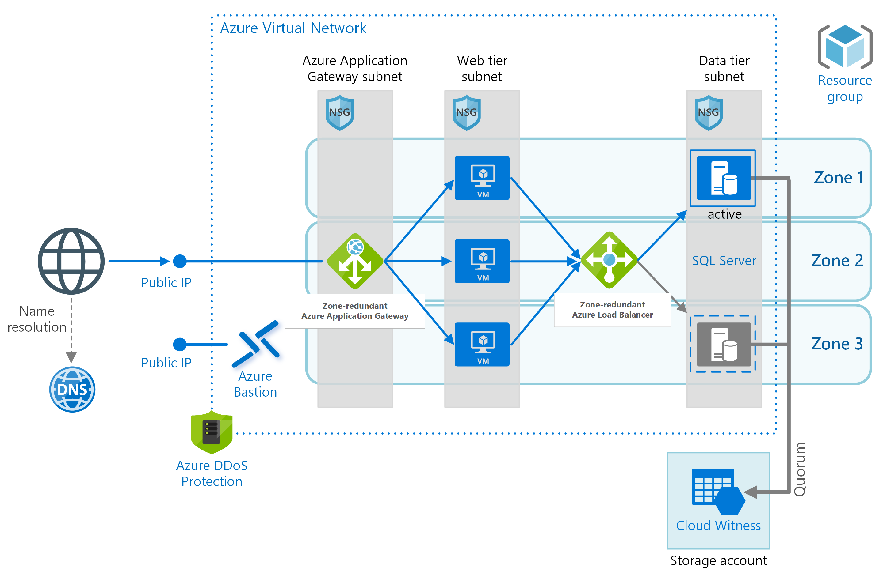


Terraform Architecture
Modules
*.tf
*.tfvar
Azure Cloud Provider
Plugins

Slide 3
Terraform Provider
provider "azurerm" {
version = "2.12.0"
features {}
}
Authentication
# Configure the AWS Provider
provider "aws" {
version = "~> 2.0"
region = "us-east-1"
}

Slide 4
Authentication
Authentication
Authenticating to Azure using the Azure CLI
Authenticating to Azure using Managed Service Identity
Authenticating to Azure using a Service Principal and a Client Certificate
Authenticating to Azure using a Service Principal and a Client Secret
Notes:
https://registry.terraform.io/providers/hashicorp/azurerm/latest/docs

Slide 5
Authentication
Authentication
We recommend using either a Service Principal or Managed Service Identity when running
Terraform non-interactively (such as when running Terraform in a CI server) - and authenticating using the
Azure CLI when running Terraform locally.
Notes:
https://registry.terraform.io/providers/hashicorp/azurerm/latest/docs

Slide 6
Authentication
Logging into Cloud9 env
sudo -i
cd /opt
curl -sL https://azurecliprod.blob.core.windows.net/rhel7_6_install.sh | sudo bash
https://registry.terraform.io/providers/hashicorp/azurerm/latest/docs/guides/azure_cli
az login
To sign in, use a web browser to open the page https://microsoft.com/devicelogin and enter the code E8EG4B39M to authenticate.
az account list
Enter azure portal user id and pwd
az account set --subscription="SUBSCRIPTION_ID"
az account set --subscription="6f685cfb-69f5-46d3-994a-08eb46d69d68"
Notes:
https://docs.microsoft.com/en-us/cli/azure/install-azure-cli-linux?pivots=apt
https://registry.terraform.io/providers/hashicorp/azurerm/latest/docs/guides/azure_cli

